Slide 1
What is the prime age/height/weight for an NBA player? Can we predict the stats based on these features?

Slide 2
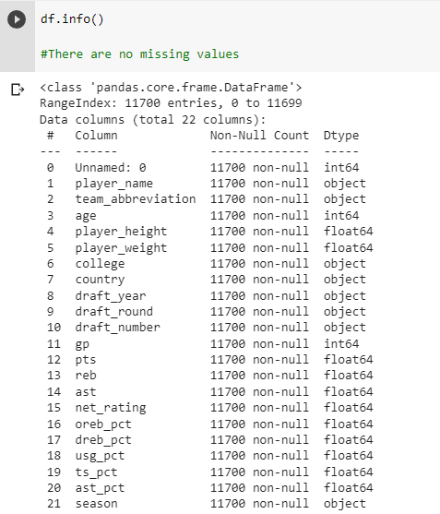
Dataset
Data includes players/stats from 1996 season to 2021. We are using age,height, and weight to predict stats.
We will drop ‘Unnamed: 0’, ‘college’, ‘country’, ‘draft_year’, ‘draft_round’, ‘draft_number’
Before running any models, I am predicting that more height and weight will equal more ‘reb’, oreb_pct’, and ‘dreb_pct’. These stats mean who can get to the ball at the end of a possession. Height gives players a big advantage.
Smaller players will have more ‘ast’ and ‘gp’. These stats mean who is able to control the ball more and who can play more games.

Slide 3
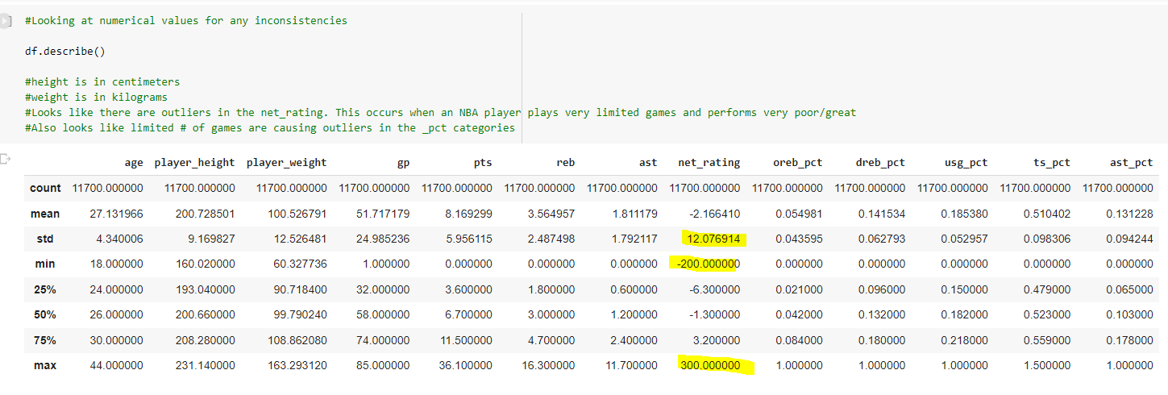
Cleaning Process
There were no duplicates and no missing values in the dataset. However, we do see some potential for big outliers

Slide 4
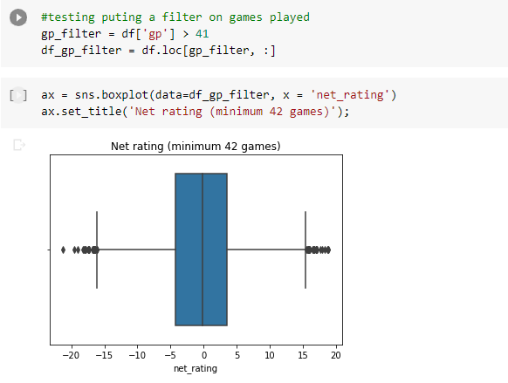
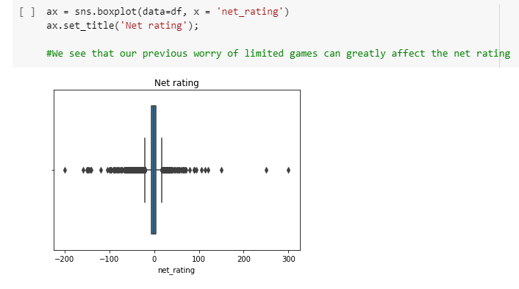
Cleaning Process

Slide 5
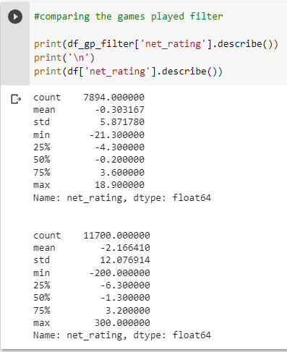
Cleaning process

Slide 6
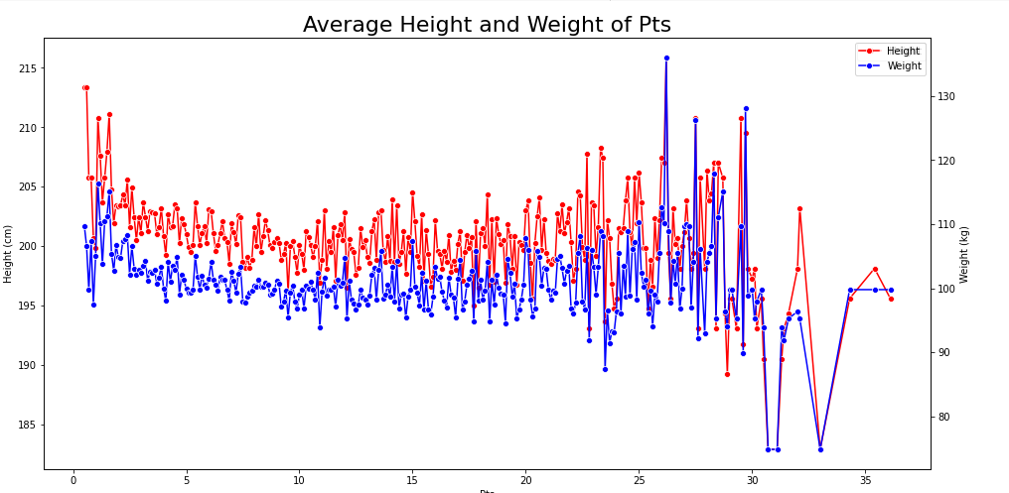

Slide 7
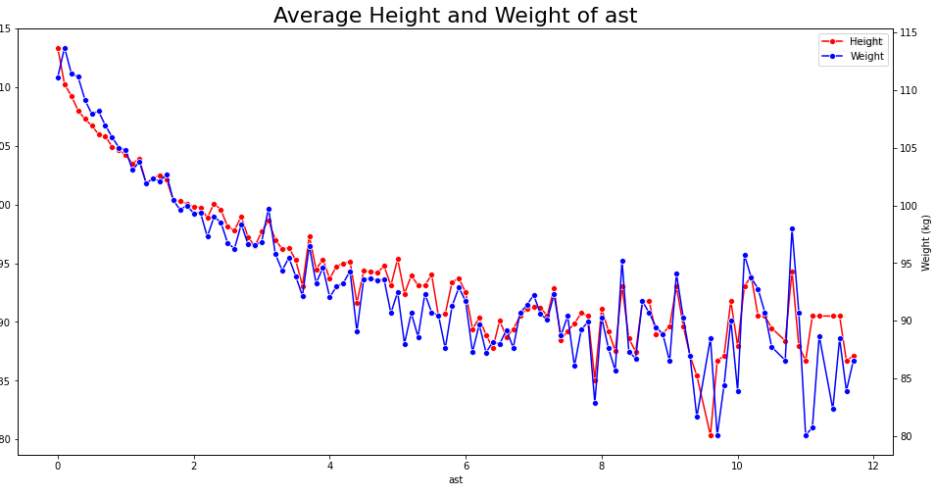
Net rating

